Slide 1
Analyzing the Operations of Wagner PMC in Africa: A Data-Driven Approach to Understanding and Preventing Human Rights Violations.
Instructor:
Dr. Dustin White
ECON-8320-001:Tools for Data Analysis

Slide 2
Contents:
Introduction
Research Objectives
Methodology
Results
Conclusion
References

Slide 3
Introduction:
The Wagner Group is a private military company (PMC) with alleged Russian government and military ties.
The group has been involved in various African countries, particularly the Central African Republic (CAR), since 2018.
The Wagner PMC has been accused of violating human rights, including torture and civilian killings.
This project uses data analysis and web scraping techniques to gain insights into the scope and patterns of the Wagner PMC's African activities, focusing on the CAR.
The findings of this project could contribute to efforts to prevent further human rights abuses and promote stability in the affected regions.

Slide 4
Research Objectives:
Gather comprehensive data on the Wagner PMC's operations in Africa by utilizing web scraping techniques, such as Python's Selenium, to collect information from online sources.
Clean the collected data to focus on relevant information, filter out irrelevant data points, handle missing values, and transform the data into a structured format suitable for further analysis.
3.Analyze the data to identify patterns and trends in the company's activities, shedding light on their strategies, the individuals involved, and the potential repercussions on regional stability and human rights.

Slide 5
Methods:
The project uses web scraping techniques and data analysis methods to gather, clean, and analyze data on Wagner PMC's operations in Africa.
The primary tools used in the project include Python, Selenium, and Pandas for web scraping, data cleaning, and preprocessing.
The project collected data from various sources, including ACLED, The Guardian, and BBC, to gain a comprehensive view of Wagner PMC's activities in different African countries.
The collected data was cleaned and preprocessed using pandas to ensure accuracy and consistency.
Finally, the cleaned data was analyzed to derive insights into patterns and trends in Wagner PMC's activities.

Slide 6
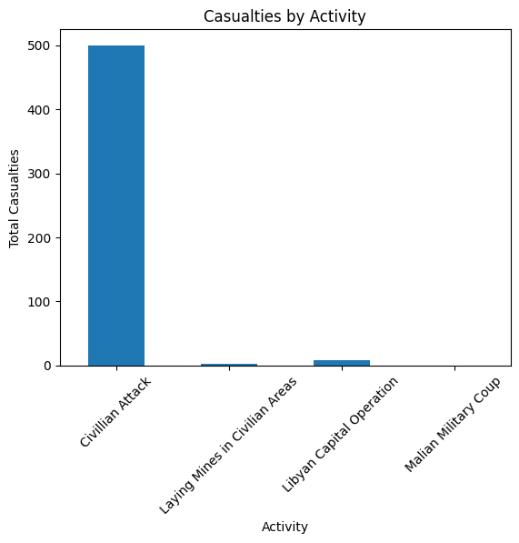
Result:
Activity_name | Casualities | Date | Location | Persons_involved | Time
Malian military coup | N/a | May-22 | Mali | Wagner pmc | 0000
Civilian attack | 500 | Late March 2022 | Moura region of Mali | Wagner | 0000
Laying mines in civilian areas | 2 | May 26 2022 | Libya | Kremlin | 05.15 bst
Libyan capital operation | 8 | March 20 2020 | Tripoli | Evropolis prigozhin | 0000

Slide 7
Conclusion:
The analysis of Wagner PMC's activities in Africa has provided valuable insights into the patterns and trends of the organization. These insights can help inform the work of policymakers, security agencies, and human rights organizations in their efforts to counter the company's operations and prevent further human rights abuses.

Slide 8
Reference:
ACLED. (2022). Wagner Group Operations in Africa: Civilian Targeting Trends in the Central African Republic and Mali. Retrieved from https://acleddata.com/2022/08/30/wagner-group-operations-in-africa-civilian-targeting-trends-in-the-central-african-republic-and-mali/
The Guardian. (2022). Russian mercenaries accused overuse of mines and booby traps in Libya. Retrieved from https://www.theguardian.com/world/2022/may/25/russian-mercenaries-accused-over-use-of-mines-and-booby-traps-in-libya
BBC. (2022). Inside the shadowy world of Russian mercenaries. Retrieved from https://www.bbc.co.uk/programmes/p09rkcsw

Slide 9


`

